Slide 1
Hospital Database System
Designed by Markuss Saule,
April 3rd, 2025
ITM 220 Final Project
Notes:
This project represents a comprehensive hospital management system designed to streamline patient care, staff coordination, and administrative tasks. Our goal was to create a real-world applicable database with a focus on scalability and usability.

Slide 2
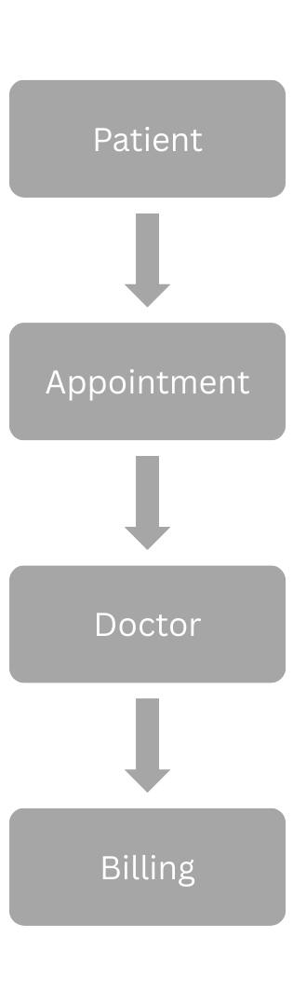
Objective
To design a relational database for a hospital to manage patient care, staff operations, billing, and insurance claims efficiently.
Track patient demographics, medical history, and appointments.
Coordinate doctors, nurses, and departments.
Handle billing, insurance, and medication inventory.
Real-World Application: Supports hospital administration by reducing manual errors, improving data accessibility, and enhancing patient care delivery.
Notes:
We chose a hospital system because it’s complex enough to require 12+ tables yet relatable for practical use. The database ensures all critical hospital functions—patient care, staff management, and financial tracking—are interconnected, reflecting real-world needs.

Slide 3
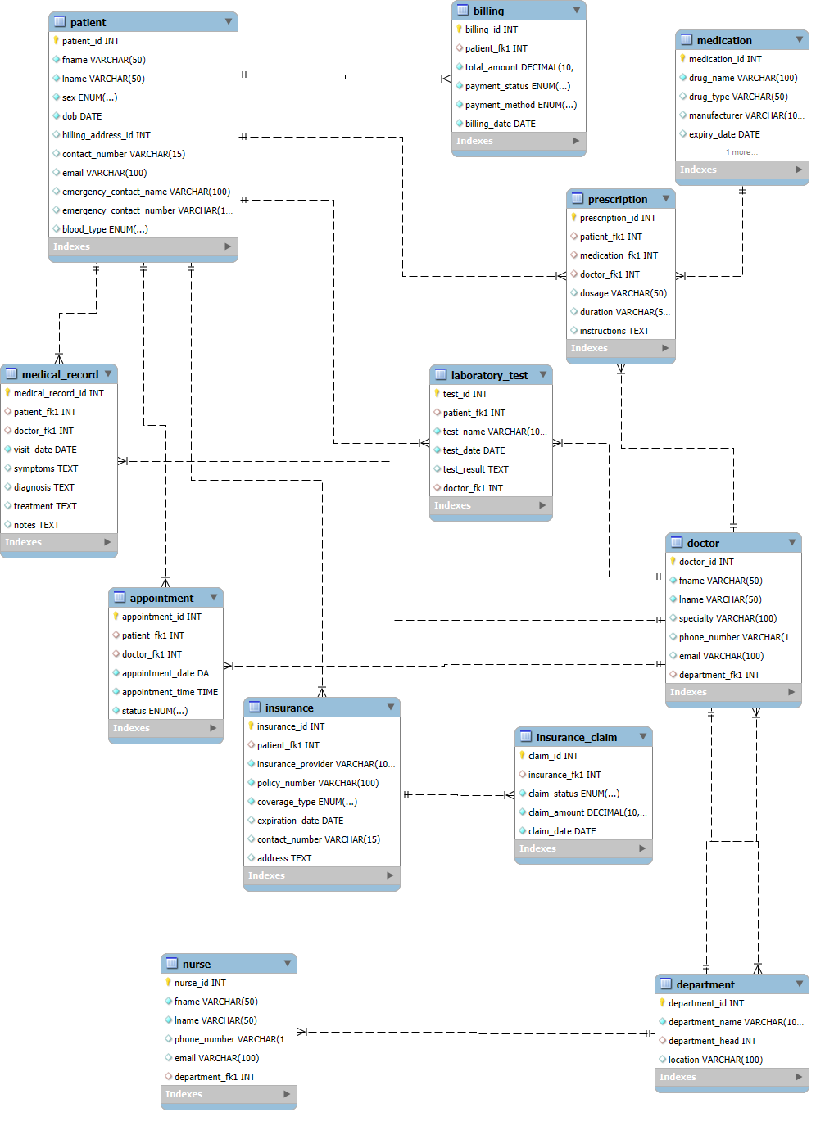
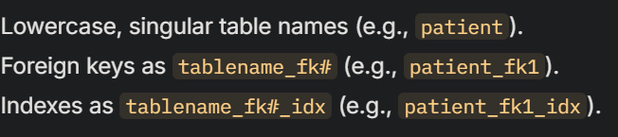
ERD Overview
Entity-Relationship Diagram (ERD): 12 Tables
Naming Conventions Followed:
Relationships: Manually defined with referential integrity.
Notes:
The ERD was designed with 12 tables to exceed the minimum requirement, ensuring a robust system. Relationships like doctor to department allow tracking of staff hierarchy, while patient links to multiple tables (appointment, billing, etc.) for comprehensive patient management.

Slide 4
Rationale – why these tables?
- patient: Core entity for storing personal and emergency info (e.g., blood_type, emergency_contact) - doctor & nurse: Separate for role-specific data and department assignments - department: Organizes staff and resources by specialty (e.g., Cardiology) - appointment: Tracks scheduling with status (Scheduled, Completed, Cancelled) - billing & insurance: Manages financials with payment_status and coverage_type - medical_record, laboratory_test, prescription: Detailed patient care tracking - medication: Inventory management with stock_quantity and expiry_date.
Notes:
Each table serves a distinct purpose: patient is the central hub, while auxiliary tables like insurance_claim and laboratory_test add depth. We used ENUMs (e.g., sex, blood_type) for data consistency and NULLable fields (e.g., email) for flexibility.

Slide 5
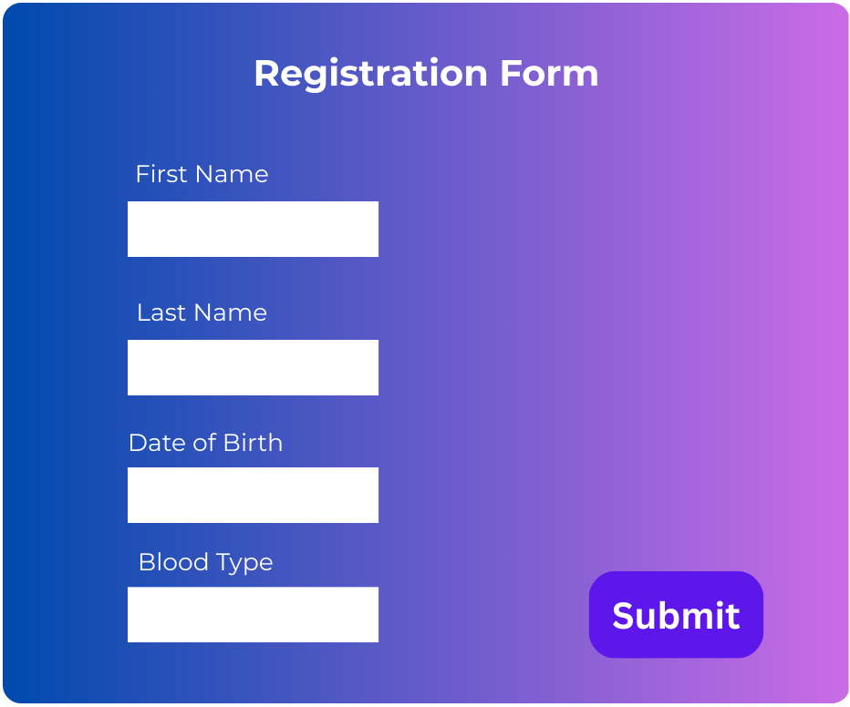
UI Forms
User Interface Goals: Intuitive, Efficient, Secure
Patient Registration: Fields for fname, lname, dob, blood_type, etc. Rationale: Quick onboarding with required fields enforced (e.g., sex, dob) Appointment Booking: Dropdowns for doctor_fk1, patient_fk1, date/time picker Rationale: Simplifies scheduling with pre-populated doctor/department options. Billing Dashboard: Displays total_amount, payment_status, linked insurance Rationale: Centralized financial overview for staff and patients.
Notes:
Forms prioritize usability: dropdowns reduce errors (e.g., selecting doctor_fk1 from doctor table), while required fields ensure data integrity. Security is implied through restricted access (e.g., only admins edit billing).

Slide 6
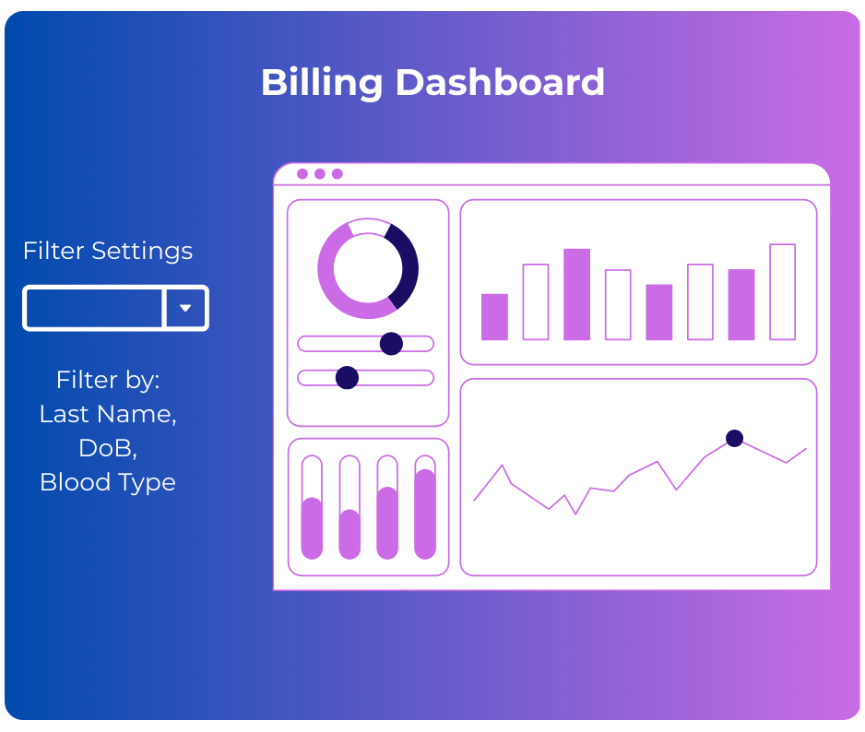
UI Forms – Additional Features
Search Functionality: Filter patients by lname or patient_id
Validation: Ensure appointment_date is future-dated, stock_quantity ≥ 0
Alerts: Notify when medication nears expiry_date or insurance claims are Pending
Rationale: Enhances staff efficiency and reduces oversight.
Notes:
We included validation to align with real-world needs—like preventing past appointments—and alerts to proactively manage inventory and claims. The search feature leverages indexes (e.g., patient_fk1_idx) for performance

Slide 7
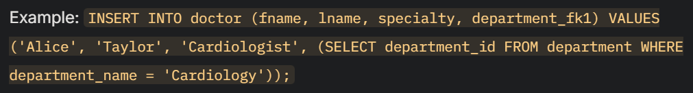
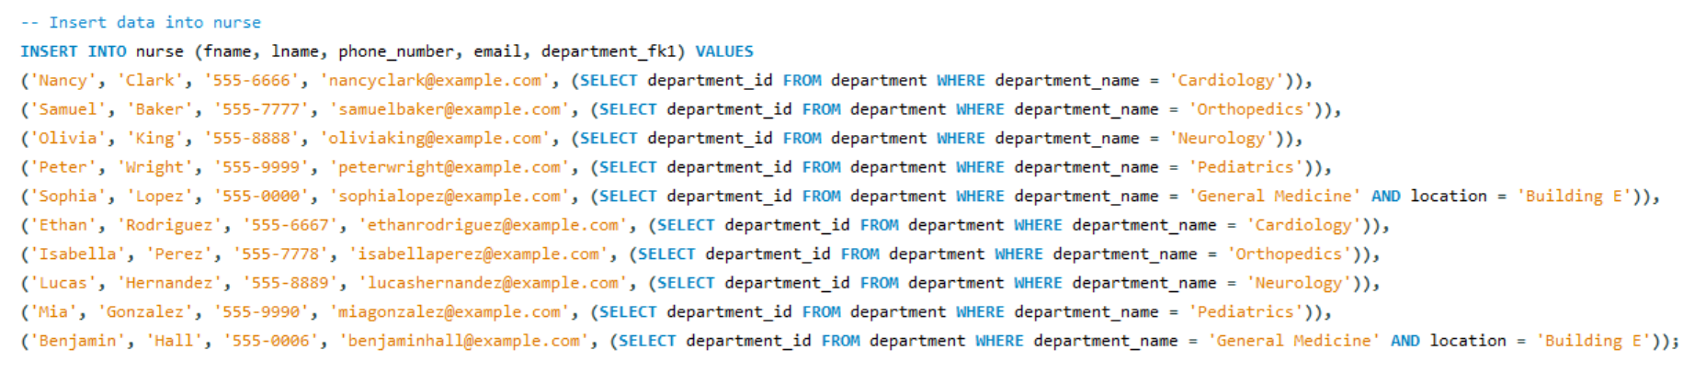
INSERT Statements
Dynamic INSERTS with Subqueries:
Transactional Structure: Wrapped in START TRANSACTION and COMMIT for data consistency Rationale: Ensures referential integrity and consistency."
Notes:
Subqueries link tables dynamically (e.g., department_fk1 to department), avoiding hard-coded IDs. Transactions prevent partial inserts, critical for a hospital where data loss could impact patient care

Slide 8
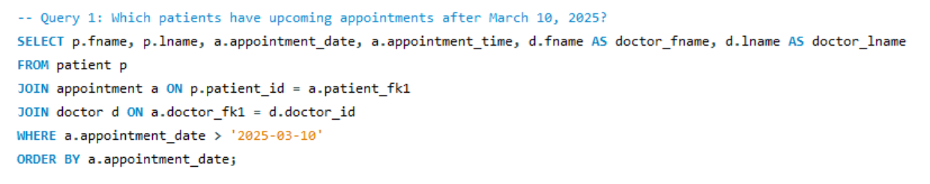
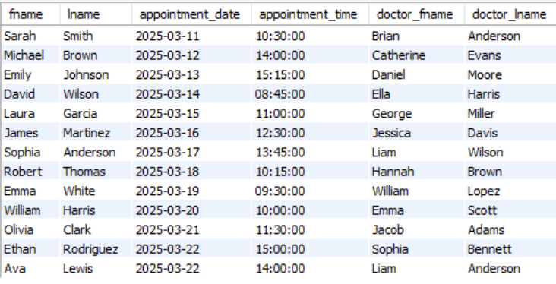
CRUD Operations (Create & Read)
Create: INSERT Statements (See Slide 7)
Read: a SELECT Query:
Notes:
This query tests the patient → appointment relationship. We chose a date filter to simulate real-time scheduling needs, ensuring the join works as expected

Slide 9
CRUD Operations (Update)
Update: Modify Existing Records Example:
Updates status while maintaining foreign key links
(sample query, not used in actual queries to cause changes in data)
Notes:
This tests the ability to update appointment statuses post-visit, a common hospital task. The subquery ensures precise targeting, validating the patient_fk1 relationship.

Slide 10
CRUD Operations (Delete)
Delete: Remove Records Safely Example: Deletes low-value cancelled bills without breaking constraints
(sample query, not used in actual queries to cause changes in data)
Notes:
We chose this DELETE to test cascade effects and constraints (e.g., no linked insurance_claim records). It simulates clearing outdated financial data, ensuring referential integrity holds

Slide 11
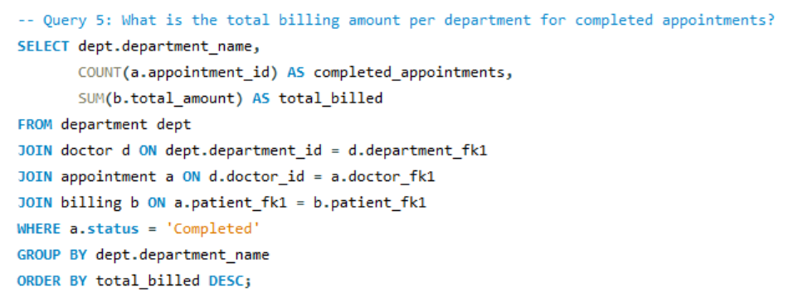
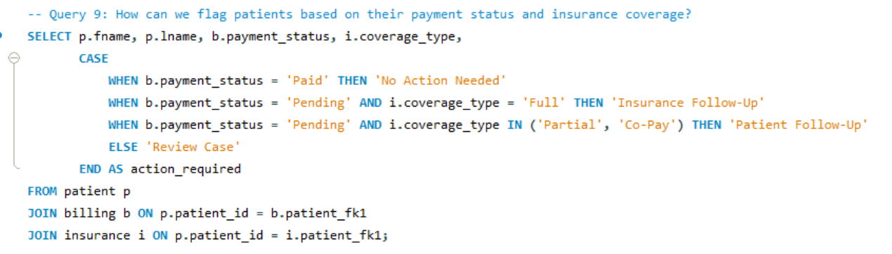
Advanced Examples
Use: Financial reporting across departments
CASE to categorize action needed based on payment_status and coverage_type.
Notes:
Query 5 tests multi-table joins and aggregation, critical for hospital budgeting. Query 9 showcases conditional logic, addressing real-world decision-making (e.g., insurance follow-ups).

Slide 12
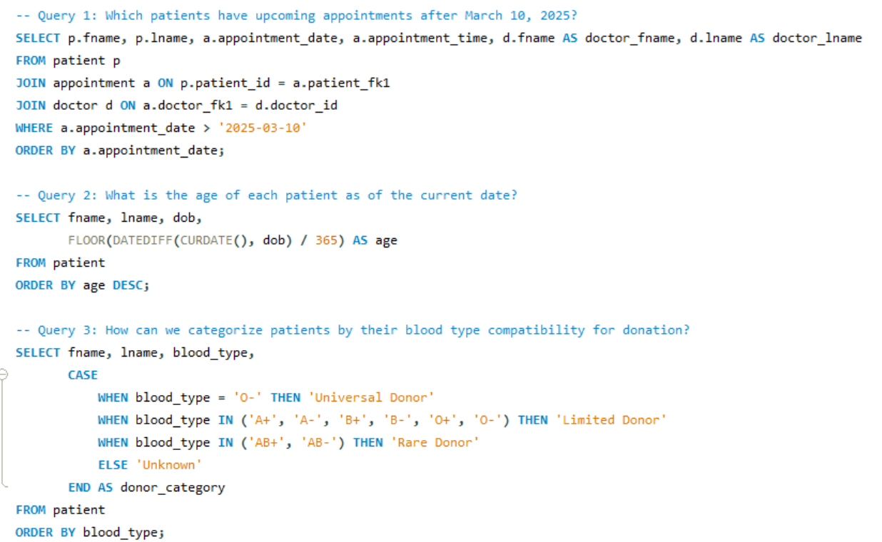
Queries 1-3
Notes:
Each table serves a distinct purpose: patient is the central hub, while auxiliary tables like insurance_claim and laboratory_test add depth. We used ENUMs (e.g., sex, blood_type) for data consistency and NULLable fields (e.g., email) for flexibility.

Slide 13
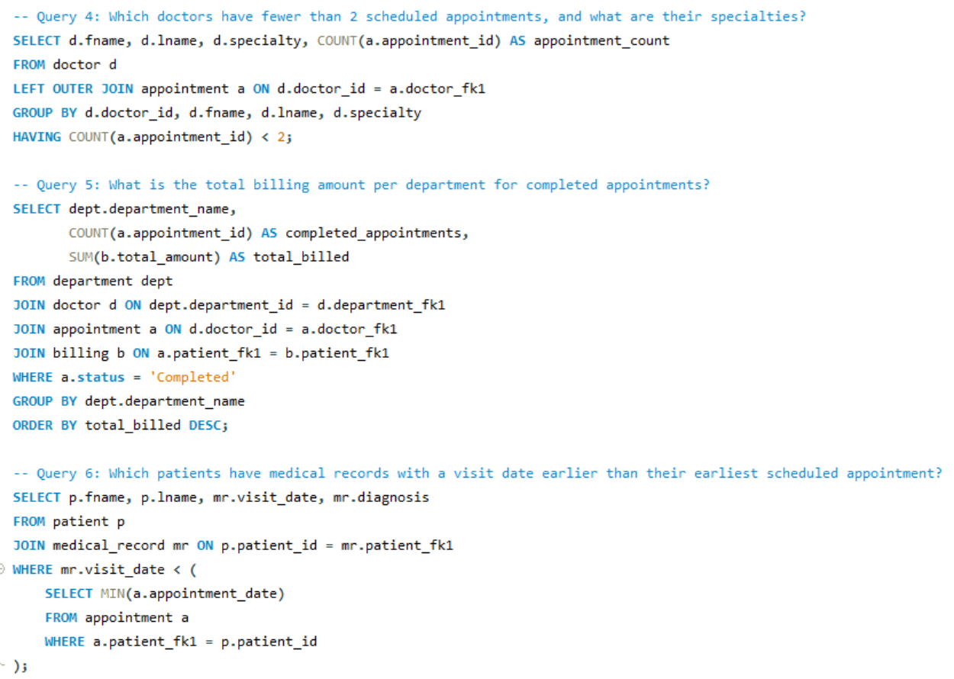
Queries 4-6
Notes:
Each table serves a distinct purpose: patient is the central hub, while auxiliary tables like insurance_claim and laboratory_test add depth. We used ENUMs (e.g., sex, blood_type) for data consistency and NULLable fields (e.g., email) for flexibility.

Slide 14
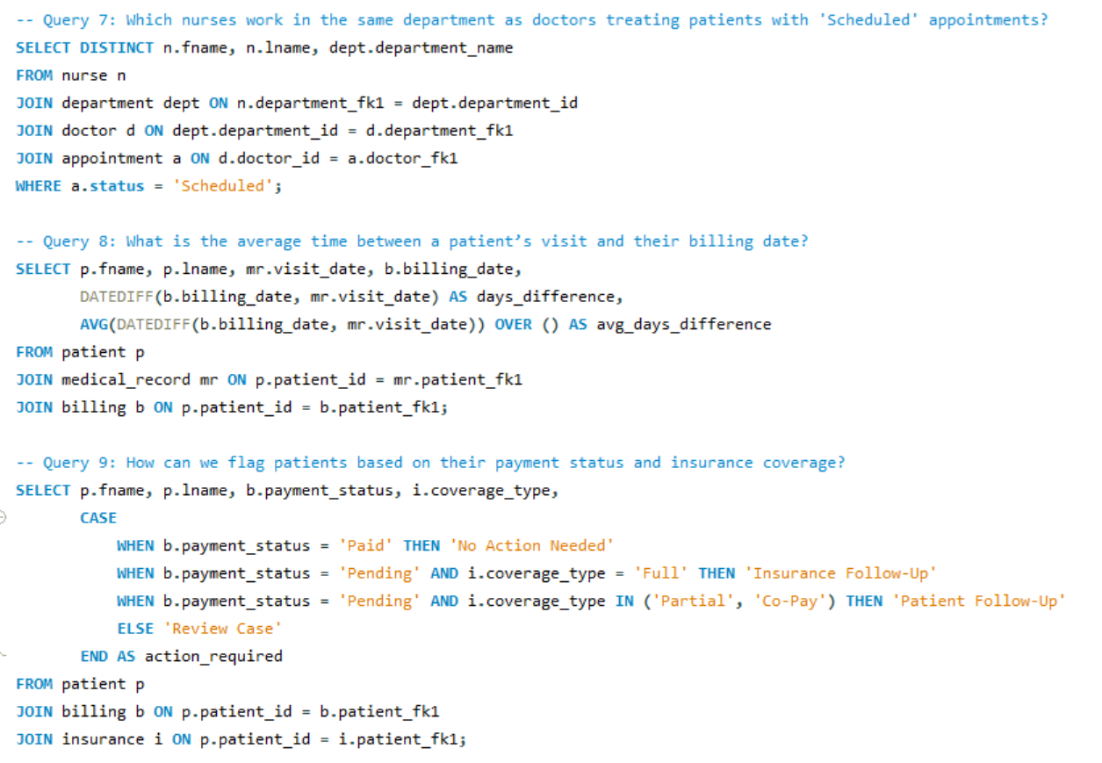
Queries 7-9
Notes:
Each table serves a distinct purpose: patient is the central hub, while auxiliary tables like insurance_claim and laboratory_test add depth. We used ENUMs (e.g., sex, blood_type) for data consistency and NULLable fields (e.g., email) for flexibility.

Slide 15
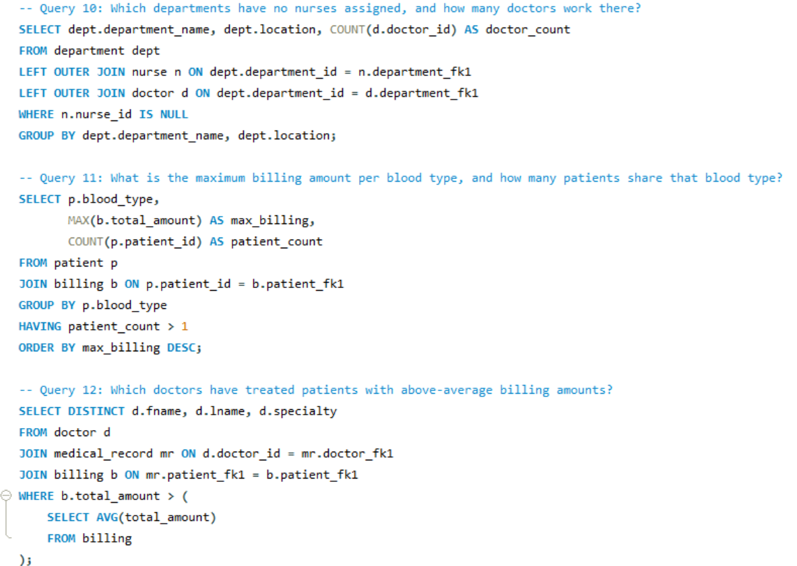
Queries 10-12
Notes:
Each table serves a distinct purpose: patient is the central hub, while auxiliary tables like insurance_claim and laboratory_test add depth. We used ENUMs (e.g., sex, blood_type) for data consistency and NULLable fields (e.g., email) for flexibility.

Slide 16
Conclusion
Summary: - Built a scalable hospital database with 12 tables - Designed intuitive UI forms for staff and patient interaction - Tested CRUD operations with robust SQL scripts Future Enhancements: Add patient portal, real-time analytics."
Notes:
Our project meets all rubric criteria: 12 tables with best practices, dynamic INSERTs, diverse queries, and a detailed presentation. It’s a foundation for a full hospital system, with room to grow.

